Slide 1
Golden exp
Game forum

Slide 2
content
About project
Resources and settings
Project plan functional
Project realize functional
Problems
Visual
Conclusion

Slide 3
This project is a web platform that unites players and developers. It is designed to host information about the game, contests and updates, as well as for convenient interaction between the community and creators. The platform provides space for guides, creativity, discussion of ideas and joint detection of errors, contributing to the development of the game and inspiring new ideas.
review

Slide 4
Resources
Python, HTML languages
Django, Pillow frameworks
SQLlite
Boostrap 5
GitHub

Slide 5
Settings
Core in python django
For images I use Pillow
Front end styles is HTML + Boostrap 5
Git for control versions
SQLlite for store data

Slide 6

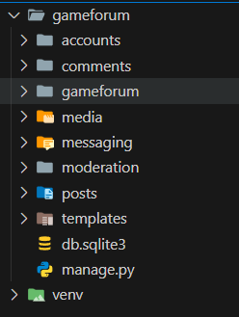
Structure
Game forum is core
Template store styles
Media for storing photos that we download from Pillow
Venv virtual environment to avoid conflicts
Db us database
Others is apps

Slide 7
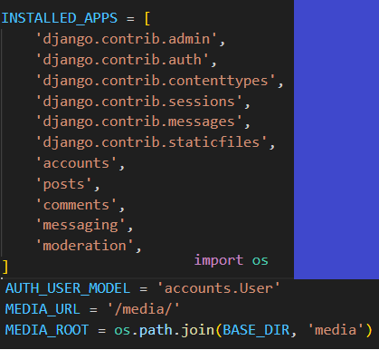
Structure
In installed apps we SHOW(INITIALIZE)APP
AUTH_USER_MODELS WE SHOW US METHOD FOR AUTH
MEDIA FOR PILLOW WORK WE CREATE A MEDIA FOLDER WHERE WE STORE IMAGES

Slide 8
plans
Registration and login – users can register via email, social networks or a game account.
Creating publications – users can post news, guides, creative works, error reports, adding text, images and tags.
Searching and filtering – the system provides convenient filters by category, popularity, date, topic and keywords.

Slide 9
plans
User interaction – the ability to comment, rate publications, chat and suggest ideas.
Moderation system – administrators and moderators check publications, remove inappropriate content and manage users.

Slide 10
Realize
Registration and login – users can register and edit their profile
Creating publications – users can post news, guides, creative works, error reports, adding text, images and tags.
Searching and filtering – the system provides convenient filters by category, popularity, date, topic and keywords.
User interaction – the ability to comment,

Slide 11
Problems and solution
Little developer experience
Complexity of role implementations
Complexity and lack of knowledge of how to use technologies alluth
Connection issues PostgreSQL
More study
More study
More study
Use another DBMS

Slide 12
NAVIGATING Q&A SESSIONS
Know your material in advance
Anticipate common questions
Rehearse your responses
Maintaining composure during the Q&A session is essential for projecting confidence and authority. Consider the following tips for staying composed:
Stay calm
Actively listen
Pause and reflect
Maintain eye contact

Slide 13
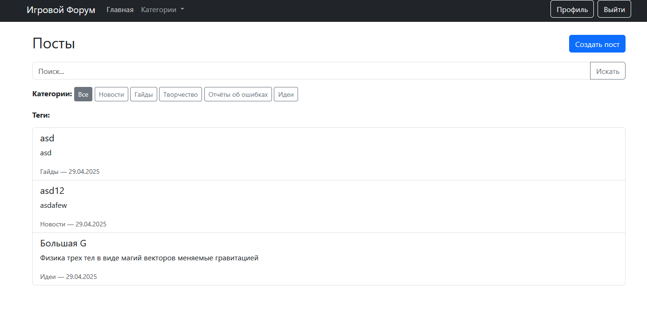

Slide 14
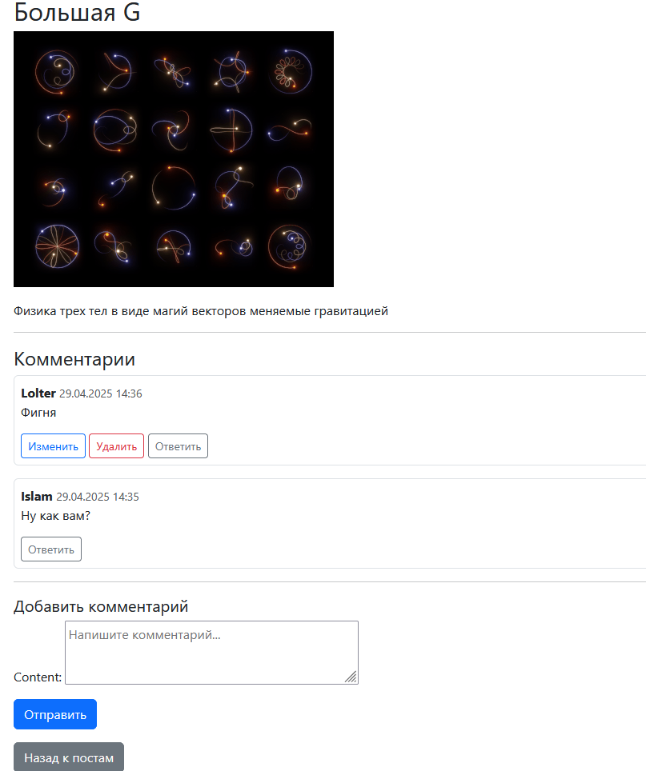
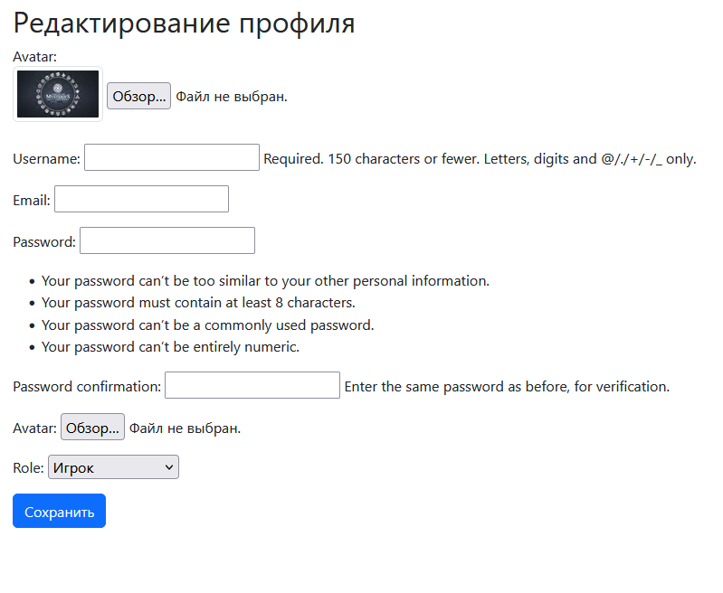

Slide 15
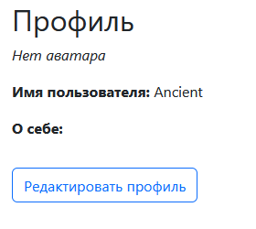
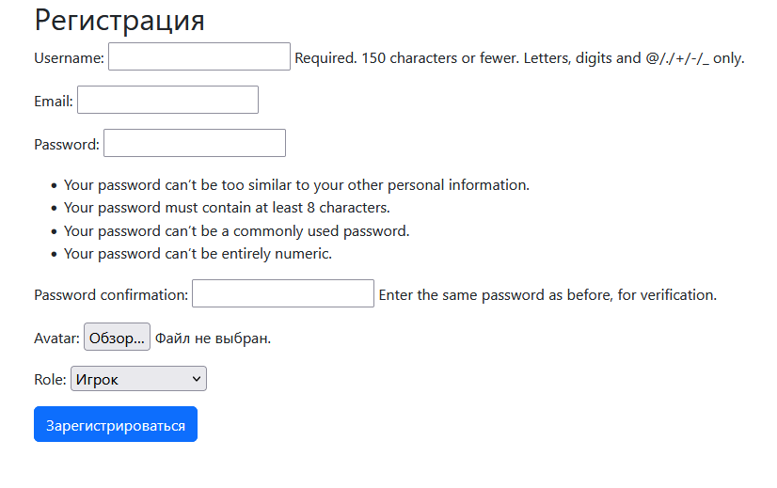
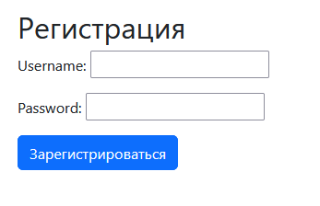

Slide 16
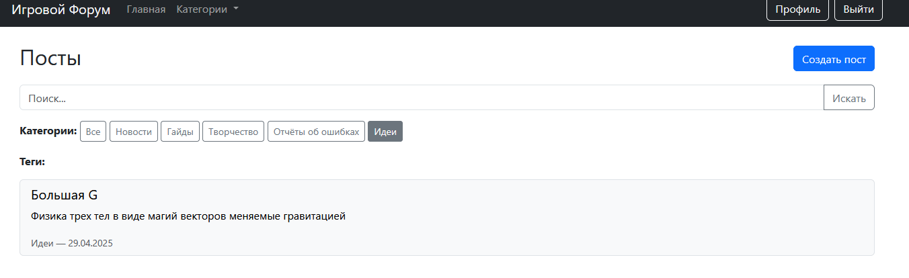

Slide 17
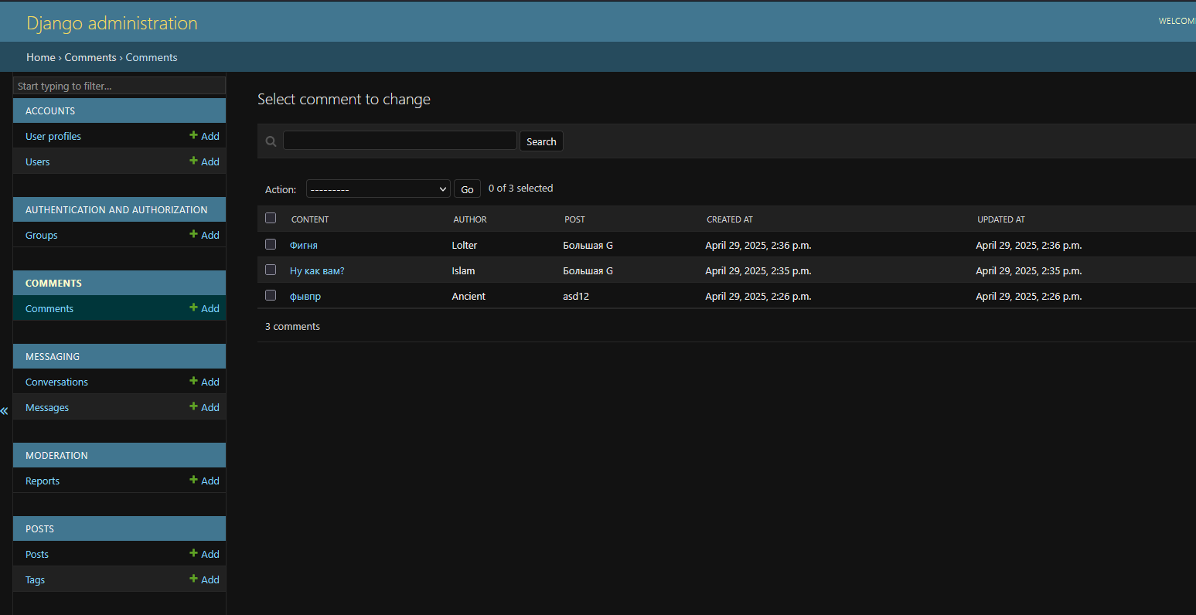

SPEAKING IMPACT
Your ability to communicate effectively will leave a lasting impact on your audience
Effectively communicating involves not only delivering a message but also resonating with the experiences, values, and emotions of those listening

Slide 18
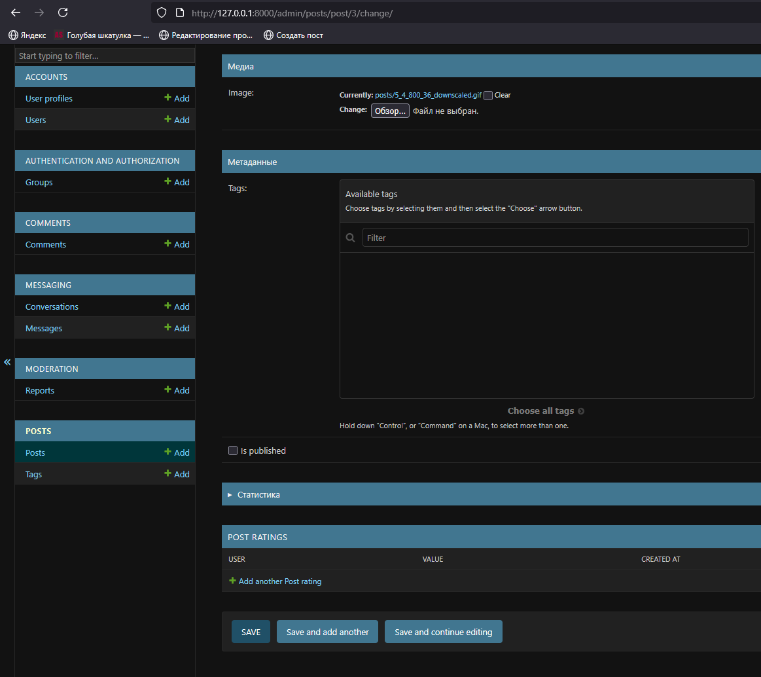
Use functions
METRIC | MEASUREMENT | TARGET | ACTUAL
Audience attendance | # of attendees | 150 | 120
Engagement duration | Minutes | 60 | 75
Q&A interaction | # of questions | 10 | 15
Positive feedback | Percentage (%) | 90 | 95
Rate of information retention | Percentage (%) | 80 | 85
As you saw, roles and boolean logic in posts are for moderations as well as DB for chat, but they are not implemented due to errors and incorrect code logic

Slide 19
A little time and the project will be ready due to lack of time and resources (Internet access) the project was unable to implement two functions out of 6, otherwise it is ready
Conclusion

Slide 20
THANK YOU
A.Islam

